Slide 1

Trajectory Data Mining: An Overview

Slide 2
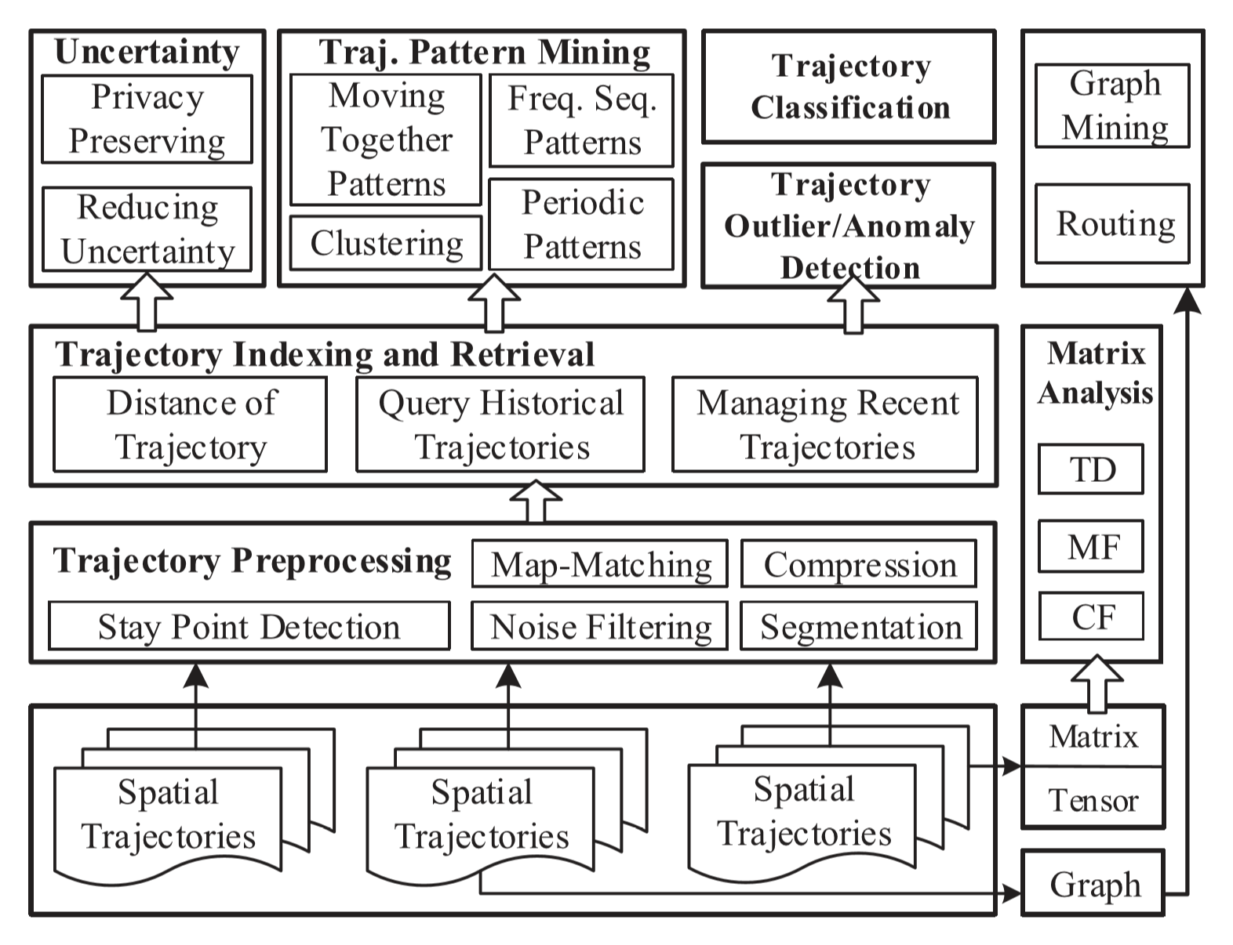
Trajectory Data Mining

Slide 3
Trajectory Data Mining
Preprocessing
Noise filtering
Removes noise points caused by poor signals
Segmentation
Segments a trajectory based on time interval, spatial shape, or semantic meaning
Map Matching
Matching trajectory onto a real map and finding the real trajectory data
Trajectory compression
Compresses the size of the trajectory data
Stay point detection
Location where a moving object has stayed for a while

Slide 4
Trajectory Data Mining
Mining Goals
Trajectory Uncertainty
Filling the gap between two trajectory records – filling unknown trajectory data
Trajectory Pattern Mining
Moving together patterns
Trajectory clustering
Periodic patterns
Frequent sequential patterns
Trajectory Classification
i.e. activities – transportation modes - …
Trajectory Outlier Detection

Slide 5
Trajectory Data Mining
Data Collection
Mobility of people:
Active recording – Passive recording
Mobility of transportation vehicles:
Taxis, buses, airplanes, …
Mobility of animals:
Animal migration, behavior, …
Mobility of natural phenomena:
Hurricanes, tornados, ocean flows, floods, …

Slide 6
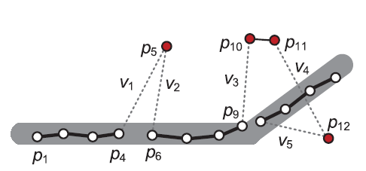

Trajectory Data Mining
Preprocessing
Noise Filtering
Mean/median filter (very much like moving average)
Kalman and Particle filters
Heuristic-Based outlier detection
Travel speed of each point
Speed threshold (e.g. 150 mph)
Stay point detection
Turning a trajectory from a series of points to a sequence of meaningful places
Trajectory compression
Online
Offline

Slide 7
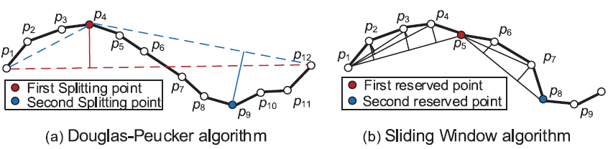
Trajectory Data Mining
Preprocessing
Trajectory compression
Offline: Douglas-Peucker algorithm
Online: Sliding window
Trajectory compression with semantic meaning
User stays, takes photos, changes direction greatly …

Slide 8
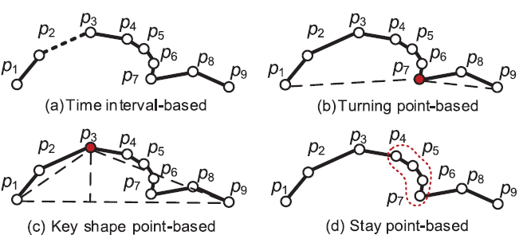
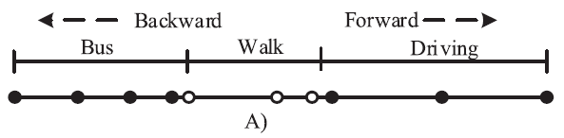
Trajectory Data Mining
Preprocessing
Trajectory segmentation
Time-interval
Turning point: slope of trajectory
Identify key data points: ex. D-P algorithm
Semantic meanings
Stay point
Transportation mode

Slide 9
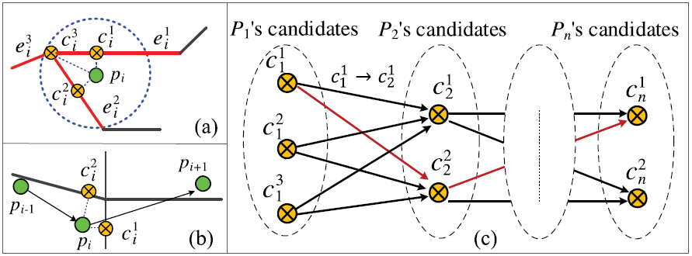
Trajectory Data Mining
Preprocessing
Map matching
Sequence of raw lat and long → road segments
Based on additional information: geometric, topological, probabilistic, advanced

Slide 10
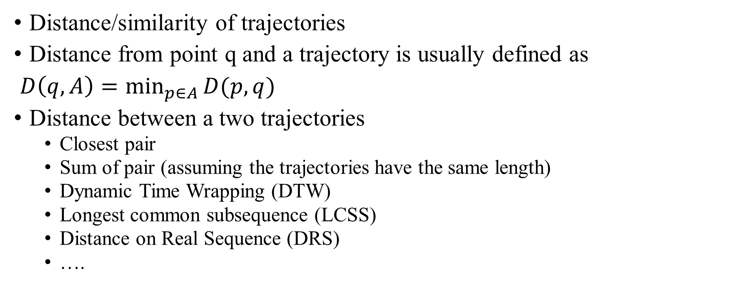
Trajectory Data Mining
Data management
Distance/similarity of trajectories
Distance from point q and a trajectory is usually defined as
$D\left(q,A\right)=\min_{p∈A}{D(p,q)}$
Distance between a two trajectories
Closest pair
Sum of pair (assuming the trajectories have the same length)
Dynamic Time Wrapping (DTW)
Longest common subsequence (LCSS)
Distance on Real Sequence (DRS)
….

Slide 11
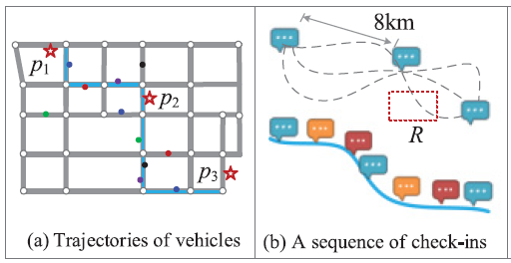
Trajectory Data Mining
Uncertainty
Path inference from uncertain trajectories
Infering path of a taxi from many taxi cabs

Slide 12
Trajectory Data Mining
Pattern Mining
Moving together patterns
Flock
Traveling companion
Convoy
Gathering
Celeberation
parade

